Slide 1
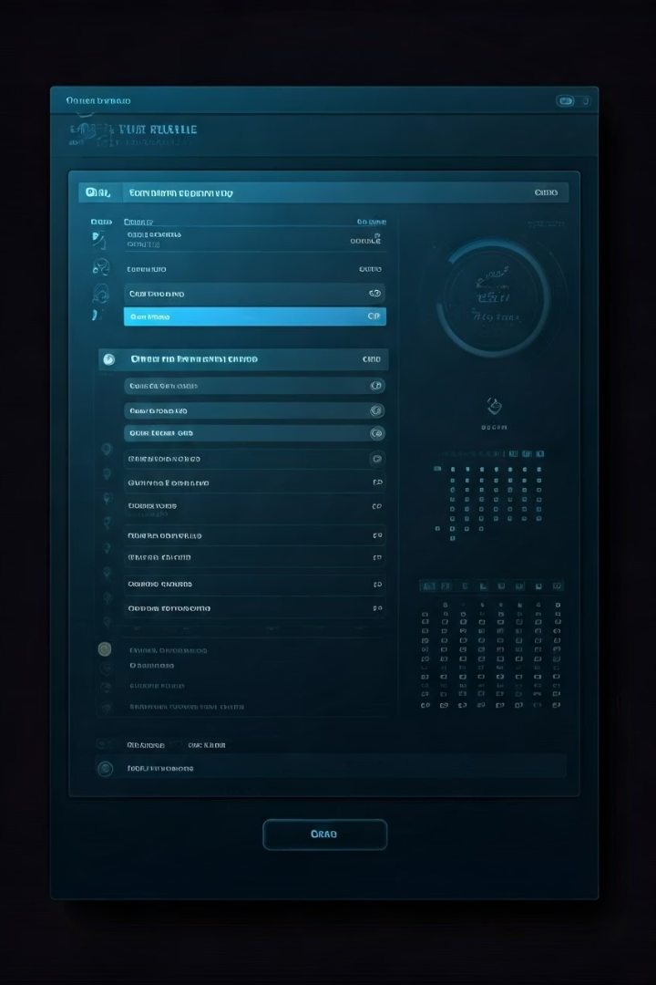
Revolutionizing Scheduling: The Online Timetable Generator

Slide 2

Traditional Scheduling Challenges
Manual Creation
Complex Constraints
Creating timetables manually is time-consuming. It can take weeks for universities.
Accommodating various constraints is complex. Scheduling conflicts cost businesses money.
Traditional scheduling methods face inefficiencies. This often leads to wasted resources and scheduling errors.

Slide 3
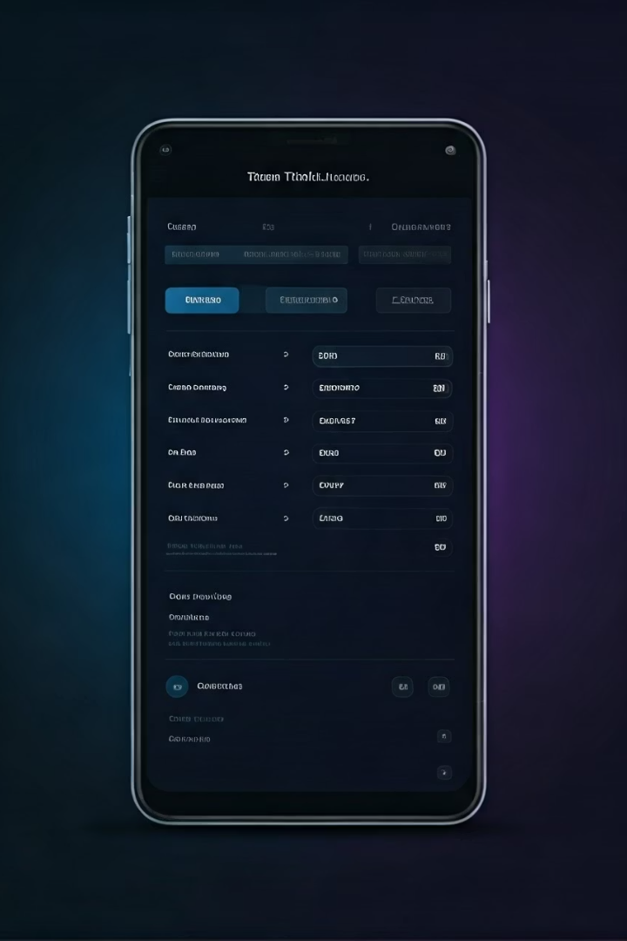
Introducing Online Timetable Generators
Automated Creation
User-Friendly Interface
Timetables are created with automated algorithms.
Easy input and management are facilitated with user-friendly interfaces.
Real-Time Detection
Conflicts are detected and resolved in real time.
Online generators offer automated timetable creation. They integrate with systems like HR software. Cloud-based access promotes seamless collaboration.

Slide 4




Key Features and Benefits
Automated Scheduling
Reduces planning time by up to 80%.
Constraint Management
Accommodates various limitations.
Optimization
Maximizes resource utilization.
Enjoy flexible customization and web-based accessibility. Data-driven insights help with continuous improvement.

Slide 5





Real-World Use Cases
Education
UC Berkeley: 30% classroom usage increase.
Businesses
Starbucks: 15% labor cost reduction.
Healthcare
Mayo Clinic: 20% patient satisfaction improvement.
Transportation
Transport for London: 10% bus punctuality improvement.
These generators streamline schedules and optimize resources. This benefits educational institutions and more.

Slide 6



Success Stories and Testimonials
Increased Efficiency
Reduced Costs
Improved Satisfaction
Organizations see increased efficiency with these systems.
Costs are reduced with optimized scheduling.
Improved user satisfaction is a key outcome.
Direct quotes from users highlight the system’s benefits. Results show efficiency and satisfaction increase.

Slide 7

The Future of Timetable Generation
AI Integration
AI and machine learning for predictive scheduling.
Enhanced Analytics
Better data analytics optimize resource allocation.
Mobile-First Design
Easy access and management on the go.
Expect integration with smart building technology. This will allow for automated resource allocation.

Slide 8






Embracing Automated Scheduling
Reduced Costs
Efficiency
Satisfaction
Adopt automated scheduling. It increases efficiency and reduces costs. It also improves satisfaction.

